Slide 1
Inyección de dependencias en Spfx, sí, se puede!
Luis Mañez
Notes:
Intro: 5 mins till Demo 1
Live demo: about 22 mins

Slide 2
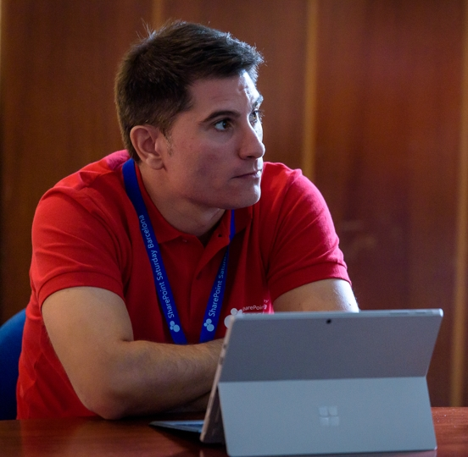
Luis mañez
Cloud Architect
ClearPeople LTD
https://github.com/luismanez
@luismanez
www.linkedin.com/in/luismanez/
MS Office Development MVP. About 15 years of experience working with Microsoft Technologies. MS Certified specialist in Developing Azure and SharePoint MCPD. Passionate about technology, blogger, technical writer and MS community active member.

Slide 4
Dependency Inversion Principle
Entities must depend on abstractions not on concretions. It states that the high level module must not depend on the low level module, but they should depend on abstractions.
My Tasks Webpart
GraphTaskService
My Tasks Webpart
ITaskService
GraphTaskService
MockTaskService
ConsoleLogger
AppInsightsLogger
ILogger
ConsoleLogger

Slide 5
Show me the code!!

Slide 6
https://github.com/luismanez/sp-saturday-madrid-2019

Slide 7
WiFi keys for attendees
Wireless network: MSFT_GUEST
Login details:
Guest Username: O365Sat@outlook.com
Guest Password: 0195
Needs to be updated!

Slide 8
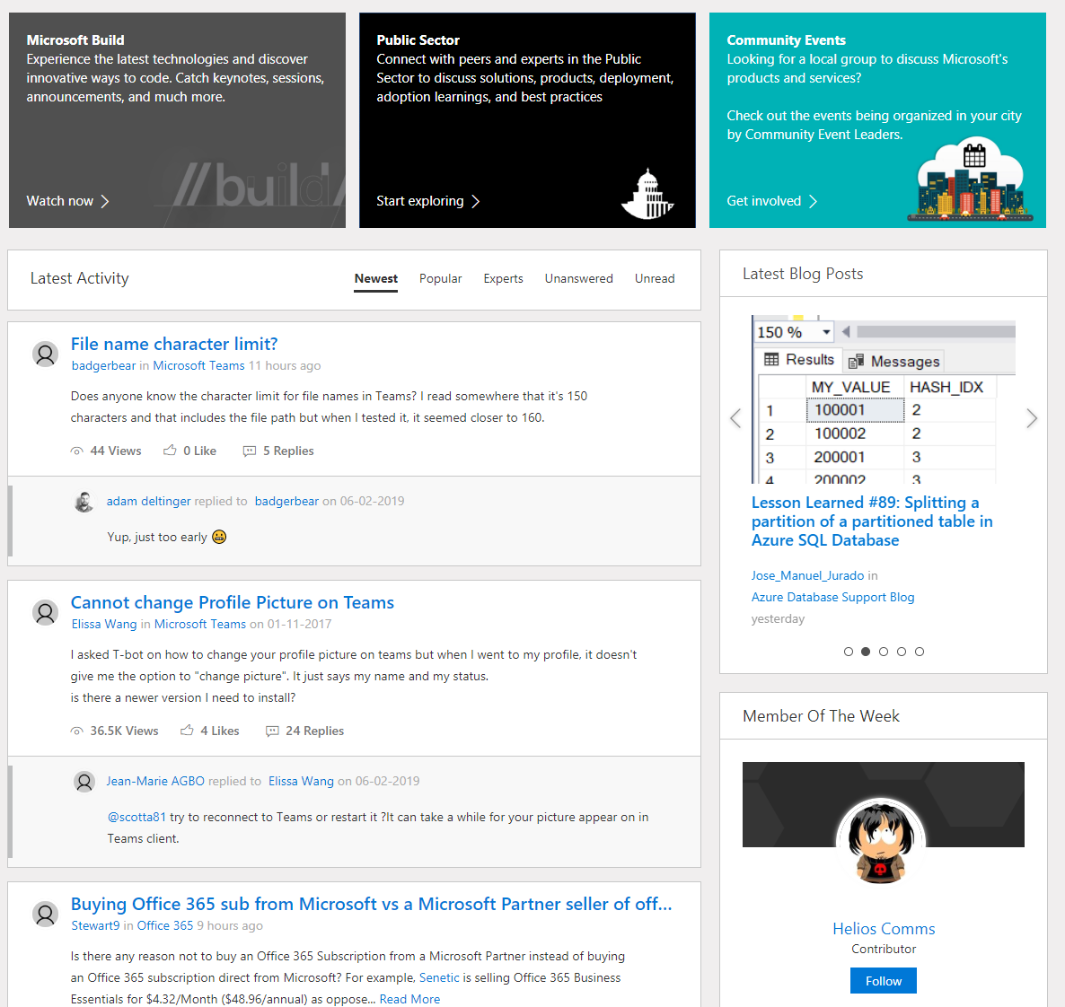
Microsoft Tech Community
techcommunity.microsoft.com
One Microsoft community for IT Pros and tech enthusiasts to learn from experts on Microsoft products
Trusted resource for news, best practices and answers from Microsoft product teams and MVPs
Join today! It’s free – sign in with your Microsoft Account.

Slide 9
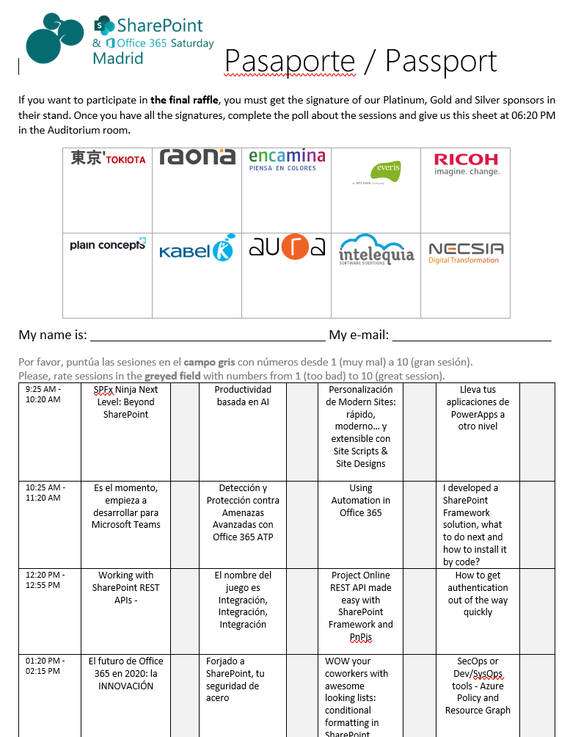





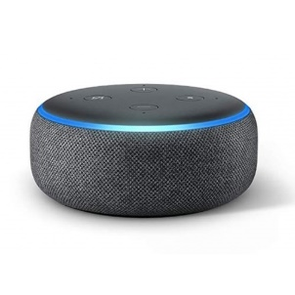


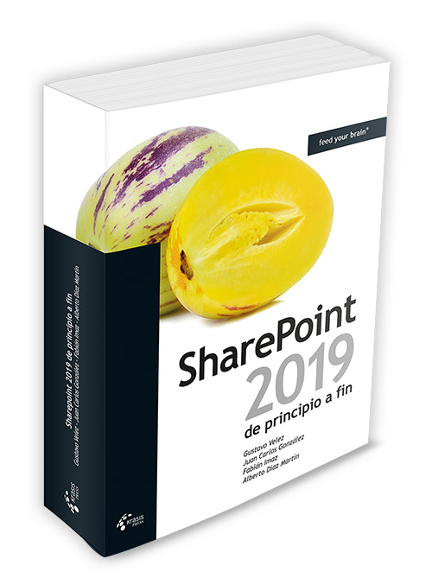
Raffle
Please, fill your SP & Office 365 Saturday Madrid passport if you want to participate.
You can win one of these gifts:
Odor
Odor@winterfell.com
2x
1x
10
1x
Needs to be updated!
1x
9
4x
2x
8

Slide 10
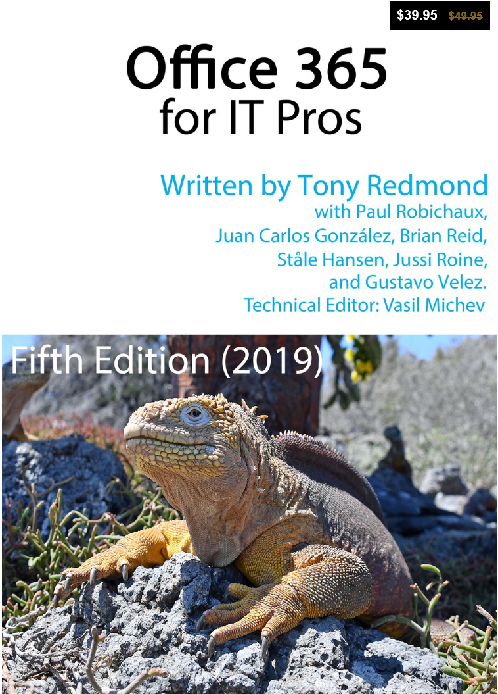
Office 365 for IT Pros
Get a 20 % discount buying the book here:
https://gumroad.com/l/O365IT/Spoisgreat

